Slide 1

Electric Vehicle Charging Analysis and Optimization
- Pooja Mengaji

Slide 2
Summary
The project aims to develop a comprehensive Excel-based analytical application that analyzes, models and forecasts key trends in electric vehicle (EV) charging behavior.
It explores various aspects of EV charging such as station utilization, cost sensitivity, driver behavior, and seasonal variations.
The goal is to create an interactive, data-driven tool that combines descriptive analytics, predictive modeling, and Monte Carlo simulation to provide valuable insights for EV infrastructure planning and energy management.
The model will help decision makers understand station performance, forecast costs under uncertainty, and identify efficiency patterns based on temperature, vehicle type, and user behavior.

Slide 3
Data Source
Primary source – Electric Vehicle Charging Patterns dataset
(Kaggle link: https://www.kaggle.com/datasets/valakhorasani/electric-vehicle-charging-patterns/data)
Additional fabricated data was generated to increase the volume and improve the quality of visualizations.

Slide 4
Architecture of the Dashboard
Dashboard
Load Data
Analyze Data
Break Even Analysis
Revenue Simulation
Import EV data (Kaggle source)
Charging Station Utilization
What-if Scenario modeling (Goal Seek)
Monte Carlo based revenue forecasting using (@Risk)
Charging Cost Sensitivity
Derive attributes
Driver Behavior Profiling
Seasonal Charging Behavior

Slide 5
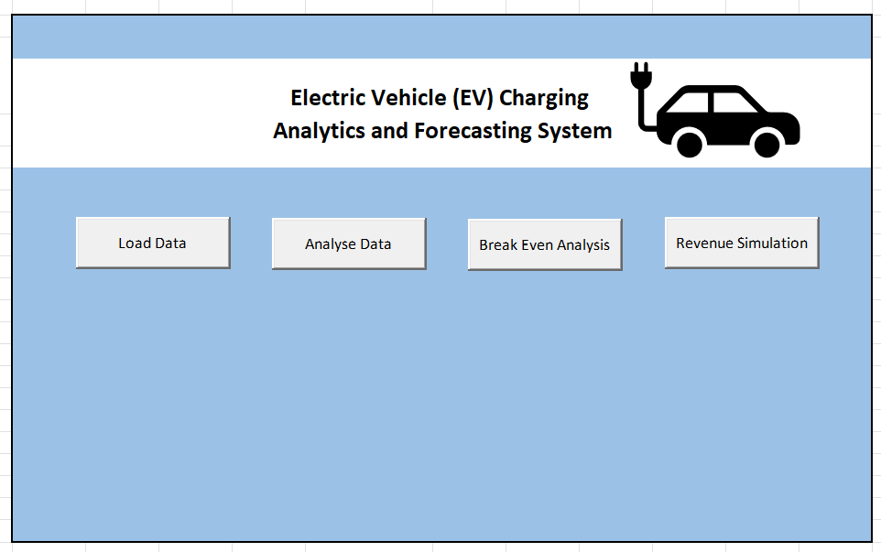
Dashboard Preview

Slide 6
Top 10 busy charging stations
Top most busy station

Slide 7
Average monthly utilization
No data

Slide 8
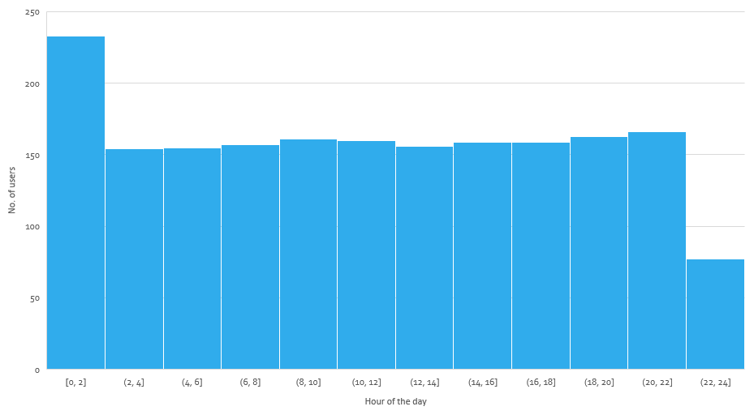
Peak hour of charging
Peak hour

Slide 9
Time-of-Day Utilization

Slide 10
Geographic utilization

Slide 11
Impact of fluctuating energy prices on cost and charging efficiency

Slide 12
Impact of temperature on cost and charging efficiency
Longer charging hours at higher temperature

Slide 13
Charging patterns based on user type

Slide 14
Charging patterns based on vehicle brands
Higher battery capacity
Higher Energy consumed

Slide 15

Thank you

